Slide 1



CYBER FOUNDATION & CTF MINDSET
CGH-X
MODULE 1 — CLASS 1
Cyber Foundation & CTF Mindset
LEARN. PRACTICE. ATTACK. DEFEND. LEAD.
Free Introductory Class | CyberHELP × FIRE Cybersecurity Community
Notes:
Welcome learners and set expectations for our first session together today. We are building real security skills from day one. Let us dive right in and get started.

Slide 2

Put your phone on the table.
Notes:
Run the live phone table demo to spark immediate curiosity. Every file you create tells a story about you. Let us learn how to listen to those stories.

Slide 3

YOUR LEARNING COMMUNITY
The path is built for beginners.
Two communities. One practical cybersecurity journey.
CyberHELP
FIRE Cybersecurity Community
Secure Help. Anytime. Anywhere.
For Intelligence, Resilience, and Empowerment
Learn with clear guidance, real tools, and a community built to help you begin.
Build the mindset to investigate, practice ethically, and keep improving.
HANDS-ON. CTF-DRIVEN. JOB-FOCUSED.
0:08–0:15
Notes:
Introduce both communities and show how this journey supports absolute beginners. You do not need prior experience here. We learn by doing, together.

Slide 4
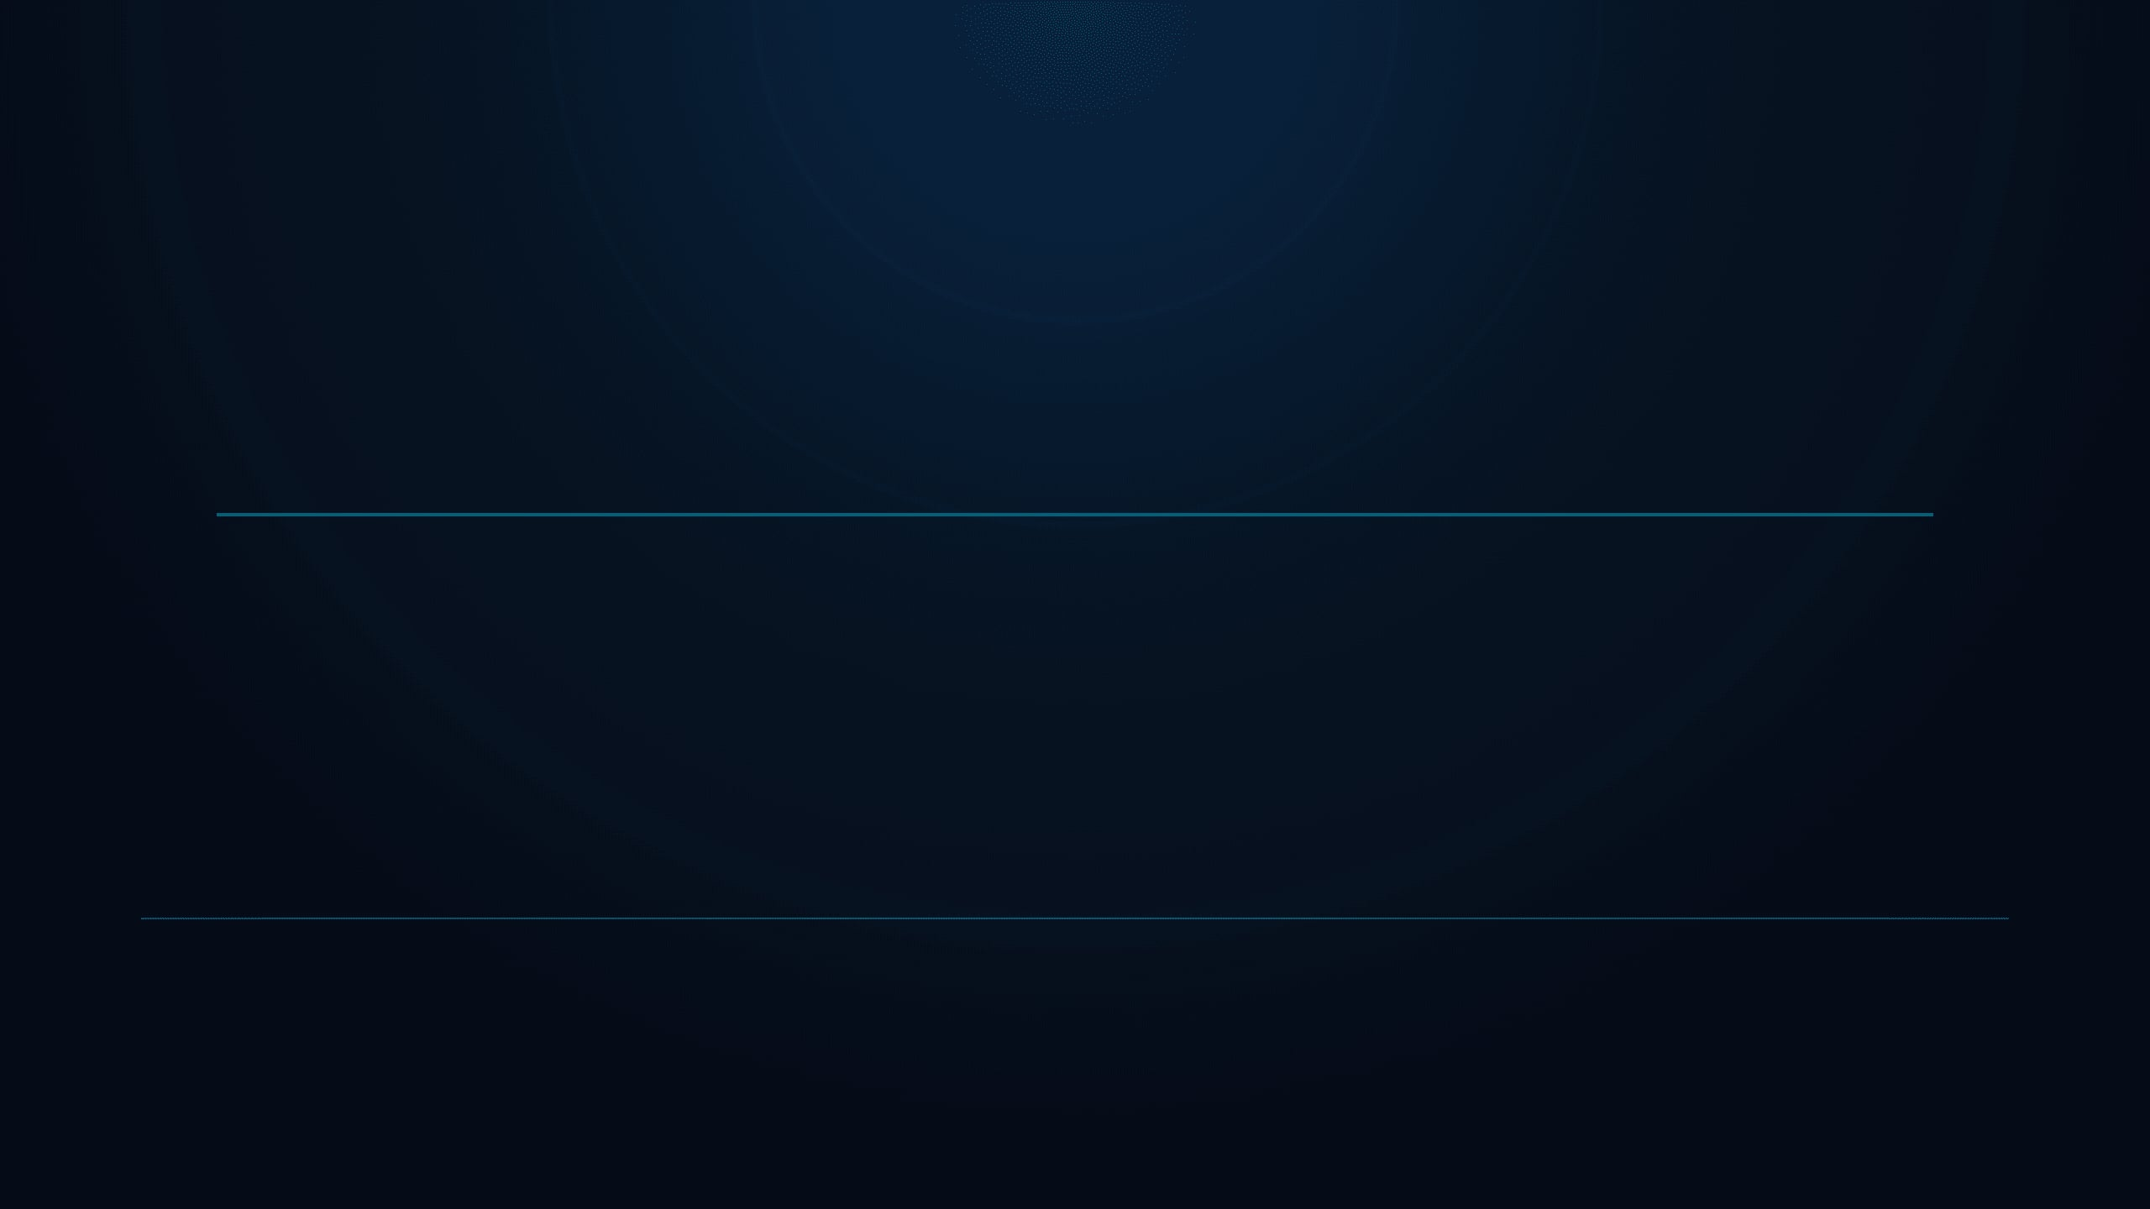
THE CGH-X JOURNEY
One foundation. Six stages.
24 WEEKS · ONE PROGRESSION
01
02
03
04
05
06
WEEKS 1–4
WEEKS 5–8
WEEKS 9–12
WEEKS 13–16
WEEKS 17–20
WEEKS 21–24
Cyber Foundation & CTF Mindset
Web Security & Core VAPT
Network & System Testing
SOC, DFIR & Threat Hunting
Advanced Red Team Simulation
Capstone & CISO Simulation
Your starting point
How web systems break
Find and test exposure
Detect and investigate
Operate like an adversary
Prove what you can do
Today: establish the mindset, the rules, and the first tools.
YOU ARE HERE → MODULE 1
0:08–0:15
Notes:
Walk through the roadmap across all 24 weeks to show the full journey. We start with absolute basics today and build step by step toward advanced security roles.

Slide 5

SECTION 01 — CTF MINDSET
CTFs turn curiosity into skill.
You learn by solving controlled challenges, one clue at a time.
THIS IS WHAT WE DO
LATER
Jeopardy style
Attack–Defense
Solve independent challenges. Find the flag. Earn points.
Attack other teams while defending your own services.
ONE PROBLEM → ONE BREAKTHROUGH
OFFENSE + DEFENSE AT ONCE
THE CHALLENGE CATEGORIES YOU WILL MEET
WEB
CRYPTO
FORENSICS
RE
PWN
OSINT
Web
Crypto
Forensics
Reverse Engineering
Binary Exploitation
Open-Source Intel
0:15–0:25
Notes:
Explain the capture the flag format and our core challenge categories. This is how curiosity transforms directly into practical technical skill.

Slide 6
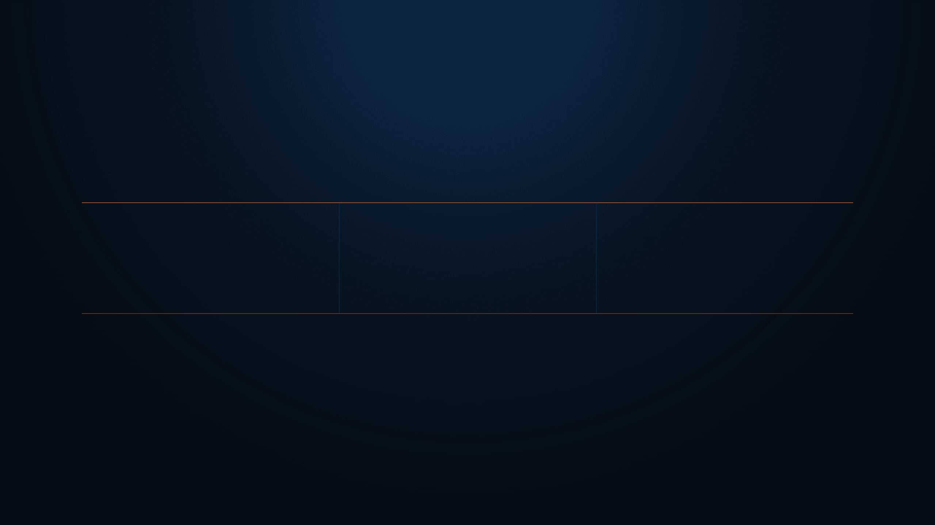
ETHICS BEFORE EXPLOITS
The rules protect the learning.
Respect the scope. Respect the people behind the systems.
!
!
!
Never share flags
Never attack anything you were not given
Never scan outside the lab
THM{y0u_f0und_1t}
The flag is the proof. Permission is the boundary.
0:15–0:25
Notes:
Security without ethics is just vandalism, and we draw that line right here. Never touch anything outside the authorized labs or share flags with peers. Establish ethics and lab boundaries clearly for the group before moving on.

Slide 7

LINUX SURVIVAL
Eight commands unlock today’s lab.
Type them. Test them. Remember them.
pwd
ls -la
cd
cat
Where am I?
Show everything, including hidden.
Move around folders.
Read a file.
file
strings
grep
find
Identify the file type.
Find readable text inside.
Search inside files.
Locate files anywhere.
IF YOUR HANDS AREN’T MOVING, YOU’RE NOT LEARNING.
0:25–0:42
Notes:
You don't need a hundred tools to start, just these eight core utilities. Master them on the command line right now. Demonstrate the eight commands live on screen so everyone sees them in action.

Slide 8

WRITE IT DOWN
WRITEUP_TEMPLATE.md
KEEP IT SHORT · KEEP IT HONEST
Professionals document the work.
Challenge:
What I saw:
A clean writeup makes your thinking visible — to you, your team, and your future employer.
What I tried — including what FAILED:
THIS LINE IS THE WHOLE POINT.
What worked:
Screenshot this slide.
Use this structure after every challenge, even the small ones.
Command used:
EVIDENCE > MEMORY
1:12–1:22
Notes:
If you didn't write it down, it never happened in security. Document your dead ends and failed attempts just as carefully as your wins. Model a concise writeup for the room using the template on screen.

Slide 9
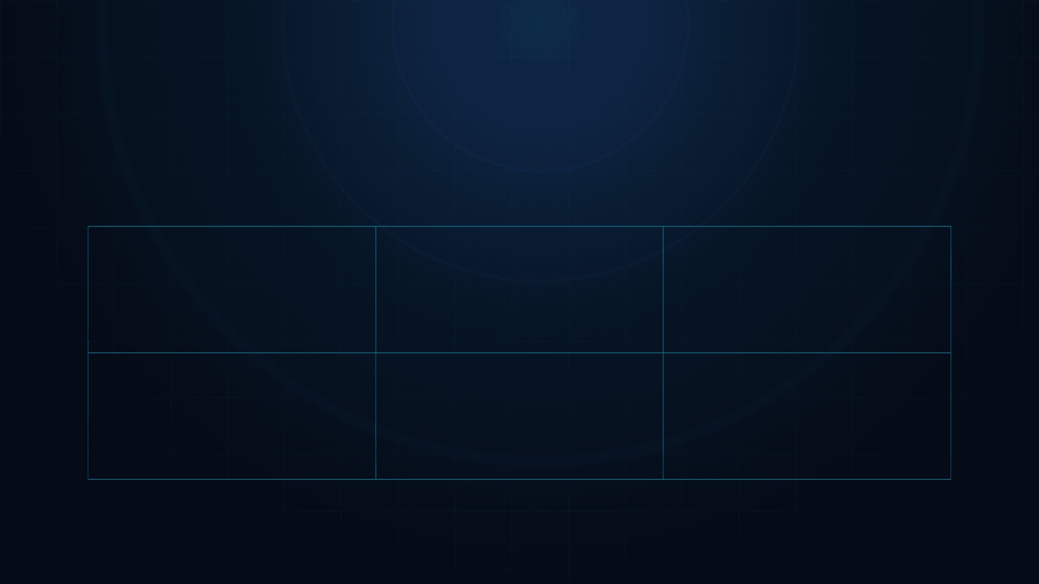
CTF MAP
The categories.
Different puzzles. One habit: observe first, then test a hypothesis.
01 / WEB
Web
02 / CRYPTO
Crypto
03 / FORENSICS
Forensics
Reverse
Engineering
PWN
06 / OSINT
OSINT
04 / RE
05 / PWN
Binary Exploitation
Open-Source Intelligence
0:15–0:25
Notes:
Every puzzle you face breaks down into one of these six core domains. Notice how each category demands a different lens, but they all share a single habit: observe first, then test a hypothesis. Let's walk through these categories together and see what kind of problems we will solve.

Slide 10

THE TARGET
What a flag looks like.
THM{y0u_f0und_1t}
This is what you’re hunting. Nothing else counts.
0:15–0:25
Notes:
This format is your ultimate objective on every single challenge you tackle. Let learners read the sample flag displayed on screen and notice the exact curly brace syntax. Every flag proves you cracked the system, and nothing else counts.

Slide 11
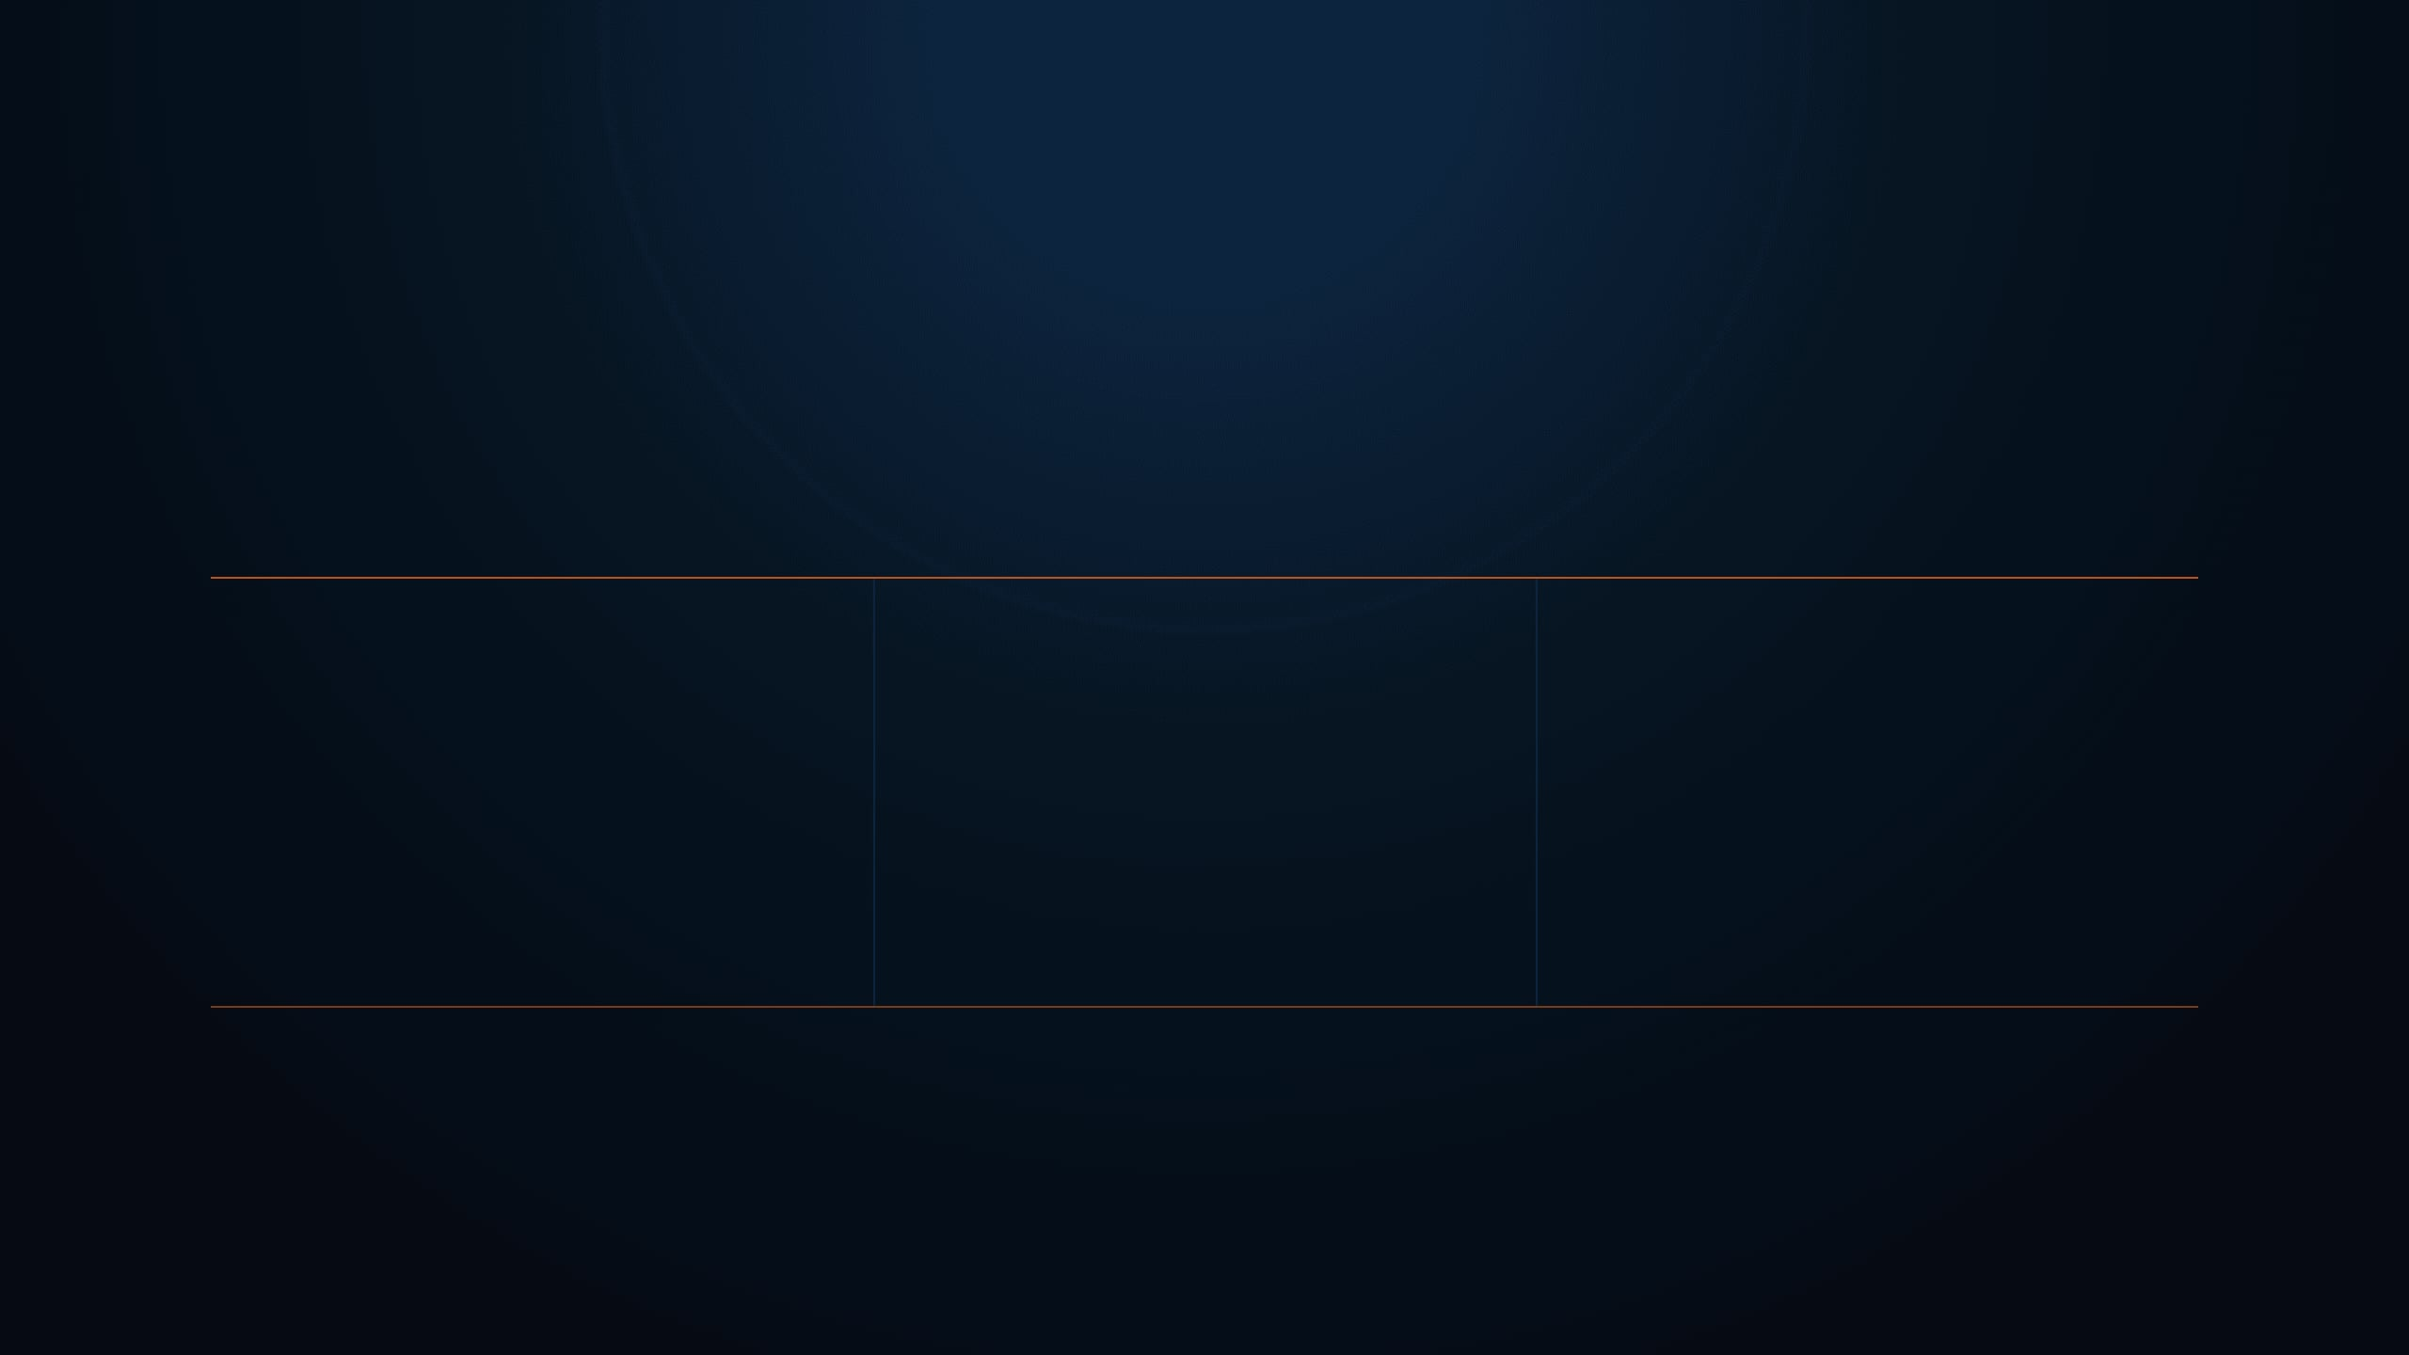
ETHICS FIRST
The rules.
The lab is a privilege. Treat it that way.
!
!
!
Never share flags
Never attack anything you weren’t given
Never scan outside the lab
Permission defines the playground.
0:15–0:25
Notes:
Enforce scope strictly right from day one of your ethical hacking journey. Remember that your lab access is a privilege, so never share flags or scan systems outside your assigned environment. Permission is what separates an authorized defender from a criminal.

Slide 12

THE LINE THAT MATTERS
“The difference between a security professional and a criminal is written permission.”
Skill is not the boundary. Permission is.
0:15–0:25
Notes:
Technical skill alone does not give you the right to break into any system you choose. Always keep written authorization in your back pocket before running any tool against a live target. That single legal boundary defines your entire career.

Slide 13

RECOVERY WORKFLOW
Try alone — 15 minutes
The Stuck Protocol.
01
Make a hypothesis. Test it. Observe the result.
Re-read the challenge description
02
Screenshot this slide. Frustration is normal; the next action should be deliberate.
The clue is often already in the wording.
Search the concept, not the challenge name
03
Learn the method, not someone else’s solution.
DO NOT SKIP TO THE ANSWER.
A professional records evidence, tests a concept, and asks for help with context.
Ask the group
04
Include what you already tried and what happened.
Then ask the instructor
05
Bring your evidence. Ask one precise question.
DON’T QUIT AT MINUTE 3. DON’T GRIND FOR 4 HOURS.
0:15–0:25
Notes:
Model the stuck protocol explicitly so learners know exactly what to do when they hit a wall. Don't quit early, and don't spend four hours spinning your wheels in silence. Follow these five steps to turn frustration into real skill development.

Slide 14

SECTION 02 — HANDS-ON BASICS
LINUX SURVIVAL
8 commands. That’s all you need today.
TYPE → OBSERVE → REPEAT
0:25–0:42
Notes:
Every security journey begins with the command line. We don't need a thousand commands to start, just eight solid ones. Type everything yourself in the lab, watch what happens, and repeat until it clicks. Instructor action: launch the Linux lab right now so everyone can log in.

Slide 15

LINUX SURVIVAL
The 8 commands.
That’s all you need today.
pwd
ls -la
cd
cat
Where am I?
Show everything, including hidden.
Move around folders.
Read a file.
file
strings
grep
find
What type is this?
Readable text inside a binary.
Search inside files.
Locate files anywhere.
IF YOUR HANDS AREN’T MOVING, YOU’RE NOT LEARNING.
0:25–0:42
Notes:
These eight commands are your basic toolkit for every challenge ahead. You check your location, peek at hidden files, read documents, and search inside binaries without getting lost. Instructor action: demonstrate commands like ls and cat live in the terminal for thirty seconds.

Slide 16
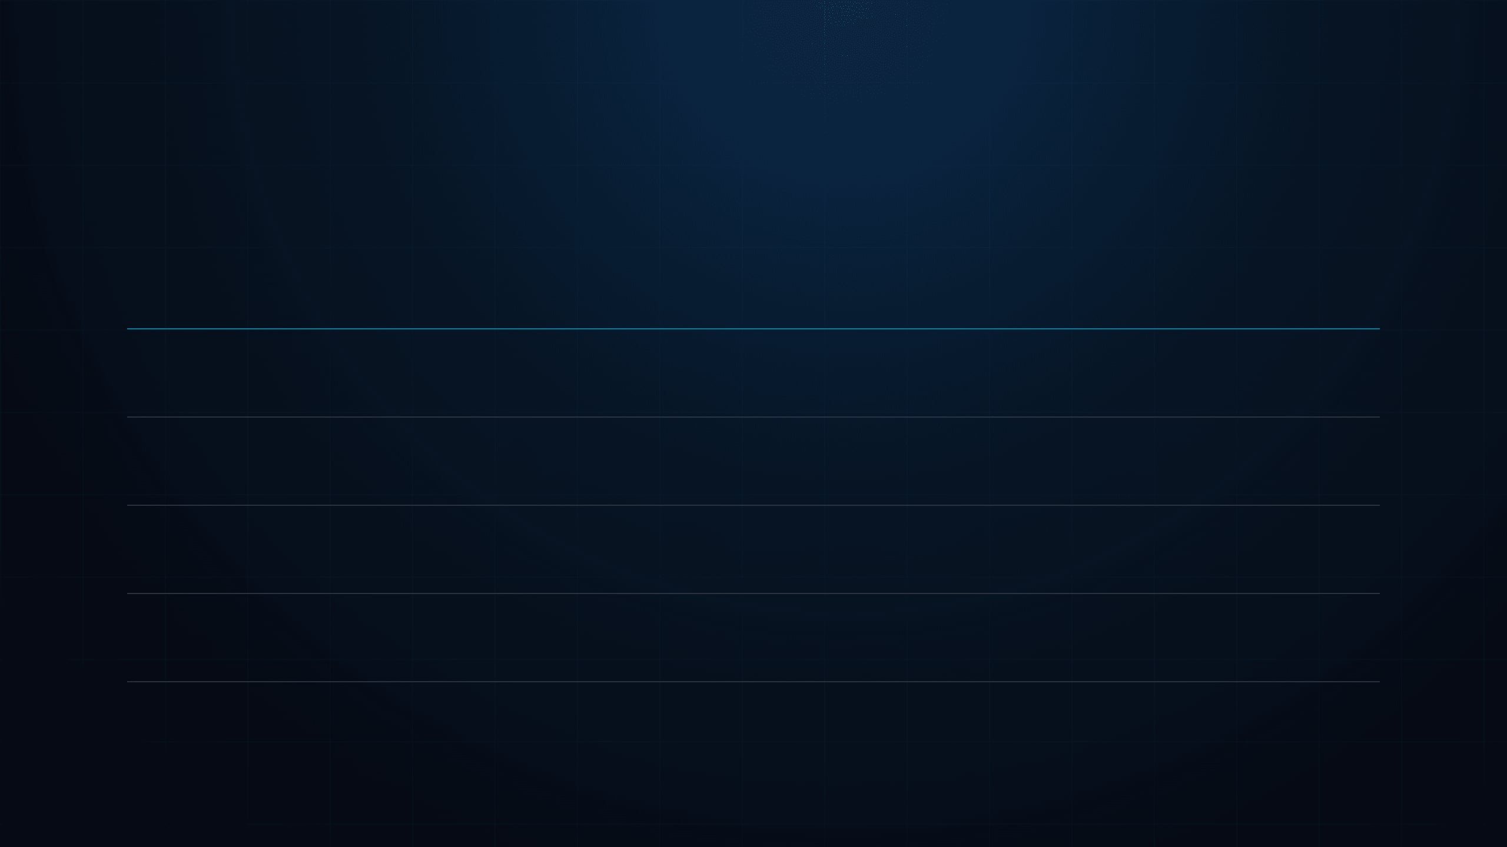
LINUX RECONNAISSANCE
Why an attacker cares.
The command is only the start.
COMMAND
WHY IT MATTERS
ls -la
→
Hidden files are where flags live.
strings
→
The fastest first look inside any binary.
grep -r
→
Beats opening files one by one.
find
→
Finds the thing when you don’t know where it is.
LOOK WIDER. SEARCH SMARTER. FOLLOW THE CLUE.
0:25–0:42
Notes:
Knowing a command is useless without knowing why you are running it. Attackers use these specific tools to find hidden files, inspect binaries instantly, and search entire systems without wasting time. Instructor action: point out categories on the screen and explain how recon saves hours of frustration.

Slide 17

RESOURCE ALERT
!
DO NOT START THE ATTACKBOX YET.
Free accounts get about 1 hour per day.
You’ll need it later in this class.
KEEP THE TIME. USE IT WHEN THE LAB REQUIRES IT.
0:25–0:42
Notes:
Please do not launch your AttackBox right now. We only get limited free time each day, and we will need every minute of it when the actual lab starts soon. Hold off and stay with us.

Slide 18

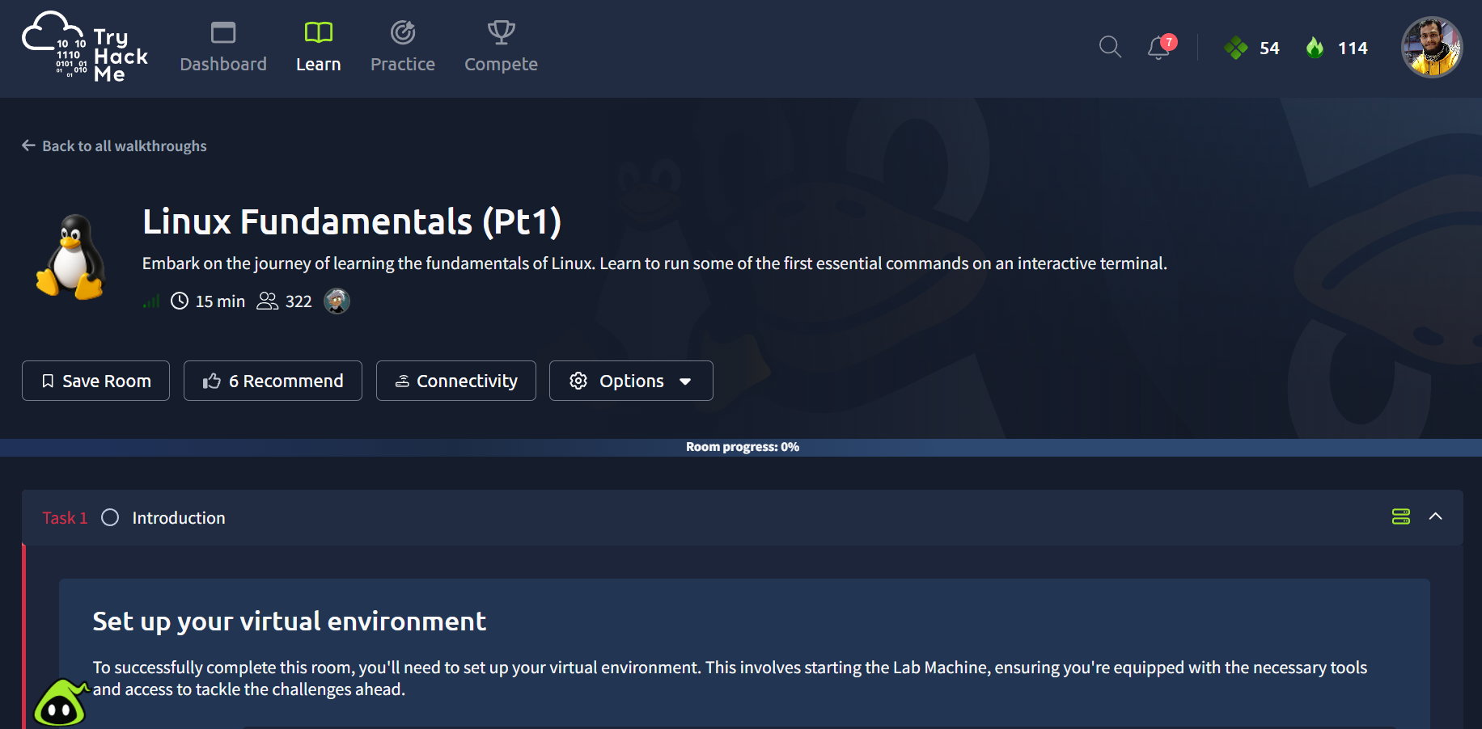
LAB 1 — LIVE PRACTICE
TryHackMe → Linux Fundamentals Part 1
Your first command-line lab.
[ screenshot: room page ]
Replace with the TryHackMe Linux Fundamentals Part 1 room page.
01
Runs in your browser — nothing to install.
02
Type every command yourself.
03
Answer the room’s questions as you go.
REMEMBER: Copying is not learning. Type it.
0:25–0:42
Notes:
Every single file you touch online is speaking about you, so let's learn how to listen. Go ahead and open the TryHackMe room now. Make sure you type each command out instead of copying and pasting, and check that everyone around you has reached the first task.

Slide 19

SECTION 03 — LIVE PRACTICE
YOUR FIRST FLAG
Everyone. Own hands. No exceptions.
NO COPY / NO GUESS / FIND THE EVIDENCE
0:42–1:12
Notes:
Every single one of you needs to complete this next task with your own hands right now. Drop the mouse and listen closely. We are not copying code and we are not guessing. Let's find that first flag together.

Slide 20

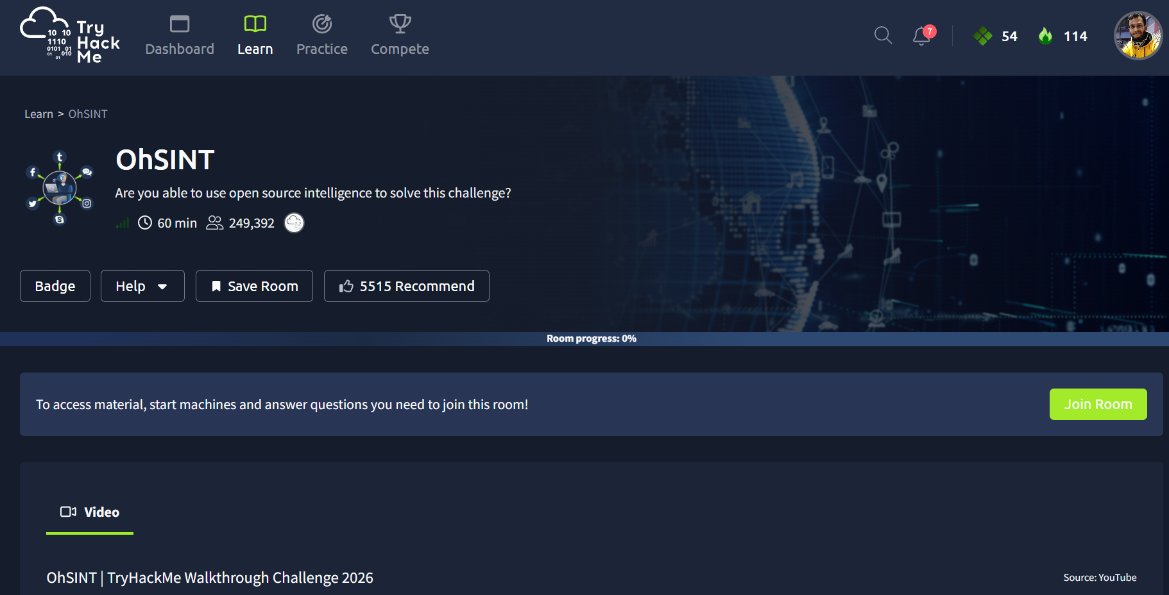
LAB 2 — LIVE PRACTICE
TryHackMe → OhSINT
Use open-source evidence. Follow the clues.
[ screenshot: OhSINT room ]
Remember the photo from the start of class.
01
Replace with the TryHackMe OhSINT room page.
02
Task 1 together, then you run.
03
Record the clue that changed your next move.
RULE: Follow evidence. Do not guess.
0:42–1:12
Notes:
Let us dive into the OhSINT room and put our reconnaissance skills to the test right now. We will tackle the first task together step by step, and then you will take over the investigation independently. Please launch the OhSINT lab and follow the digital footprint.

Slide 21

STRETCH CHALLENGE
PICKLE
RICK
Three ingredients are hidden in a web app.
01
Finished early? Keep exploring.
02
The first one is easier than you think.
A web app hides three ingredients. Your task is to find them by observing carefully and thinking one step at a time.
Look at the page.
Really look at it.
03
0:42–1:12
Notes:
For those who race through the main lab and finish early, we have a fun stretch challenge waiting for you. Take on Pickle Rick and hunt down those three hidden ingredients using careful observation. Let us offer the stretch challenge to push your web investigation skills further.

Slide 22

SECTION 04 — PROFESSIONAL HABITS
WRITE IT DOWN
This is what separates a hobbyist from a professional.
TURN YOUR STEPS INTO EVIDENCE.
1:12–1:22
Notes:
Documenting your journey is what separates an amateur hobbyist from a true professional in the field. Let us look at how recording your exact steps builds undeniable evidence of your learning process.

Slide 23

WRITE IT DOWN
WRITEUP_TEMPLATE.md
KEEP IT SHORT · KEEP IT HONEST
The writeup template.
Challenge:
A clean writeup makes your thinking visible — to you, your team, and your future employer.
What I saw:
What I tried — including what FAILED:
THIS LINE IS THE WHOLE POINT.
Screenshot this slide.
Use this structure after every challenge, even the small ones.
What worked:
Command used:
EVIDENCE > MEMORY
1:12–1:22
Notes:
Let us model the writeup format using a clean, repeatable structure that captures both your successes and your failures. Take a snapshot of this layout because every professional report relies on this exact evidence.

Slide 24

BEFORE NEXT CLASS
YOUR CHECKLIST
Homework.
□
Finish Linux Fundamentals Part 1
REQUIRED
Practice the basics while the commands and clues are still fresh.
□
Complete OhSINT
REQUIRED
ROUGHLY 2 HOURS
OF FOCUSED WORK.
□
Write 2 writeups using the template
REQUIRED
□
OverTheWire — Bandit levels 0 to 5
OPTIONAL
POST YOUR WRITEUPS IN THE GROUP. Rough work is welcome; evidence matters.
1:22–1:28
Notes:
Let us lock in today's momentum with two hours of focused practice before our next meeting. Please complete your lab rooms and post your documentation in the community group. Let us assign homework to keep your technical foundation growing stronger every day.

Slide 25
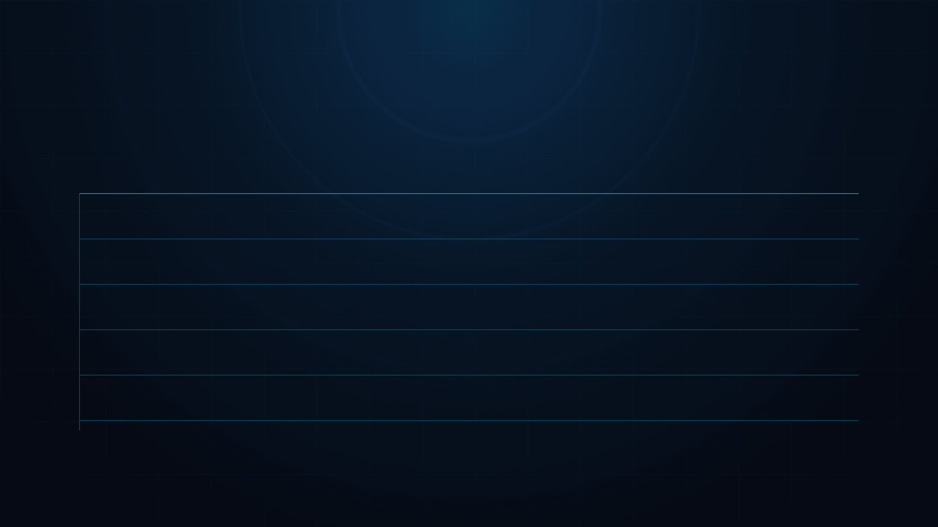
COMMUNITY PROGRESS
THE SCOREBOARD IS LIVE.
LIVE EDITABLE TABLE
Complete the rooms. Record the work. Move up together.
RANK
NAME
ROOMS COMPLETED
01
[ Mahfuz ]
[ 100 ]
02
[ shibly ]
[ 100 ]
03
[ learner name ]
[ 00 ]
04
[ learner name ]
[ 00 ]
UPDATED AFTER EVERY CLASS.
1:22–1:26
Notes:
We see our progress tracking live right here on screen as points come in from our labs. And building skills together means watching how everyone moves up through the ranks. So update the leaderboard after every class to keep the momentum going as we tackle these challenges.

Slide 26

CLASS 2 SIGNAL
Y2xhc3MgMiBpcyBjb21pbmc=
This isn’t encrypted. It isn’t even hidden.
Next class: why base64 protects nothing.
DECODE THE CLUE.
1:22–1:30
Notes:
That coded string on screen is waiting for you to decode before our next session. But we're preserving the base64 reveal for Class 2 to show you how easy it is to read. So decode the clue and see what it actually tells you.

Slide 27

CLASS 1 COMPLETE
SEE YOU NEXT CLASS
founder@cyberhelpasia.com
WhatsApp: 01977667197
CyberHELP × FIRE Cybersecurity Community
Thank you for learning, practicing, and showing up.
TRAIN. PRACTICE. PROTECT.
Notes:
Thank you for showing up and building your cybersecurity foundations with us today. Remember to reach out on WhatsApp or email if you have questions about the lab. And we'll officially close the class here until next time.

